Slide 1

201X
用于开发临床预测模型的遗传编程方法：
有症状的心血管疾病的案例研究
21821132
董建洲

Slide 2
background
遗传编程（GP）是一种能够识别大型数据集中复杂的非线性模式的进化计算方法。尽管GP相对于更典型的，频繁的统计方法方法具有潜在的优势，但其在生存分析中的应用至少是罕见的。本研究的目的是确定GP用于临床预测模型自动开发的效用。

Slide 3
Method
该论文使用了来自SMART研究的数据，分别用Cox回归技术和GP对心血管风险的发展和表现进行评分。其中，共有3,873名年龄在19-82岁的患者参加了1996 - 2006年的研究。该队列在70:30被分成派生和验证集。
Notes:
The European Union (EU), headquartered in Brussel, Belgium, is a European Community with six founding members, namely Germany, France, Italy, the Netherlands, Belgium and Luxembourg. The Alliance now has 28 Member States and 24 official languages. In December 1991, the Maastricht Summit of the European Community adopted the Treaty of the European Union, commonly known as the Maastricht Treaty. On November 1, 1993, the Treaty of Maastricht came into force and the European Union was formally born. In 2012, the European Union won the Nobel Peace Prize.

Slide 4
Implement
论文使用了无类型稳态单目标基于树的GP将符号回归模型拟合到数据中以估计离散危险，从而预测心血管事件的风险。这里的结果是离散危险率，即患者在时间间隔[t-Δ/ 2，t +Δ/ 2]期间经历事件的条件概率，假设它们在间隔开始时没有事件，与Cox回归中的持续危险率相反。该模型的优点不受比例风险假设的约束，更适合解释变量之间的任何非线性相互作用。在我们的GP实现中，预测模型是一个数学公式，没有复杂性的固有限制，如回归方法，如Cox回归。所有预测因子都被视为输入和特征选择，是进化过程的固有部分。建模过程从一组初始候选预测模型开始，然后通过选择更好的模型进行迭代优化。
Notes:
The European Union (EU), headquartered in Brussel, Belgium, is a European Community with six founding members, namely Germany, France, Italy, the Netherlands, Belgium and Luxembourg. The Alliance now has 28 Member States and 24 official languages. In December 1991, the Maastricht Summit of the European Community adopted the Treaty of the European Union, commonly known as the Maastricht Treaty. On November 1, 1993, the Treaty of Maastricht came into force and the European Union was formally born. In 2012, the European Union won the Nobel Peace Prize.

Slide 5
Result
认为Cox回归技术和GP具有可比较性，在时间点t=1，3，5年，GP和Cox回归模型的C指数分别为0.59, 0.69, 0.64和0.66,0.70,0.70。在同一时间点，使用校准曲线评估两个模型的校准和Hosmer-Lemeshow检验统计量的推广也具有可比性，但Cox效果还是更好一点
Notes:
The European Union (EU), headquartered in Brussel, Belgium, is a European Community with six founding members, namely Germany, France, Italy, the Netherlands, Belgium and Luxembourg. The Alliance now has 28 Member States and 24 official languages. In December 1991, the Maastricht Summit of the European Community adopted the Treaty of the European Union, commonly known as the Maastricht Treaty. On November 1, 1993, the Treaty of Maastricht came into force and the European Union was formally born. In 2012, the European Union won the Nobel Peace Prize.

Slide 6
Conclusion
论文证明GP自动开发的预测模型具有与手动调整的Cox回归相当的预测能力。GP模型更复杂，但它是以完全自动化的方式开发的，并且包含较少的超参数。此外，它不需要通常需要的专业知识来推导，从而减轻了知识启发的瓶颈。总体而言，GP作为自动开发用于诊断和预后目的的临床预测模型的方法显示出相当大的潜力。
Notes:
The European Union (EU), headquartered in Brussel, Belgium, is a European Community with six founding members, namely Germany, France, Italy, the Netherlands, Belgium and Luxembourg. The Alliance now has 28 Member States and 24 official languages. In December 1991, the Maastricht Summit of the European Community adopted the Treaty of the European Union, commonly known as the Maastricht Treaty. On November 1, 1993, the Treaty of Maastricht came into force and the European Union was formally born. In 2012, the European Union won the Nobel Peace Prize.

Slide 7
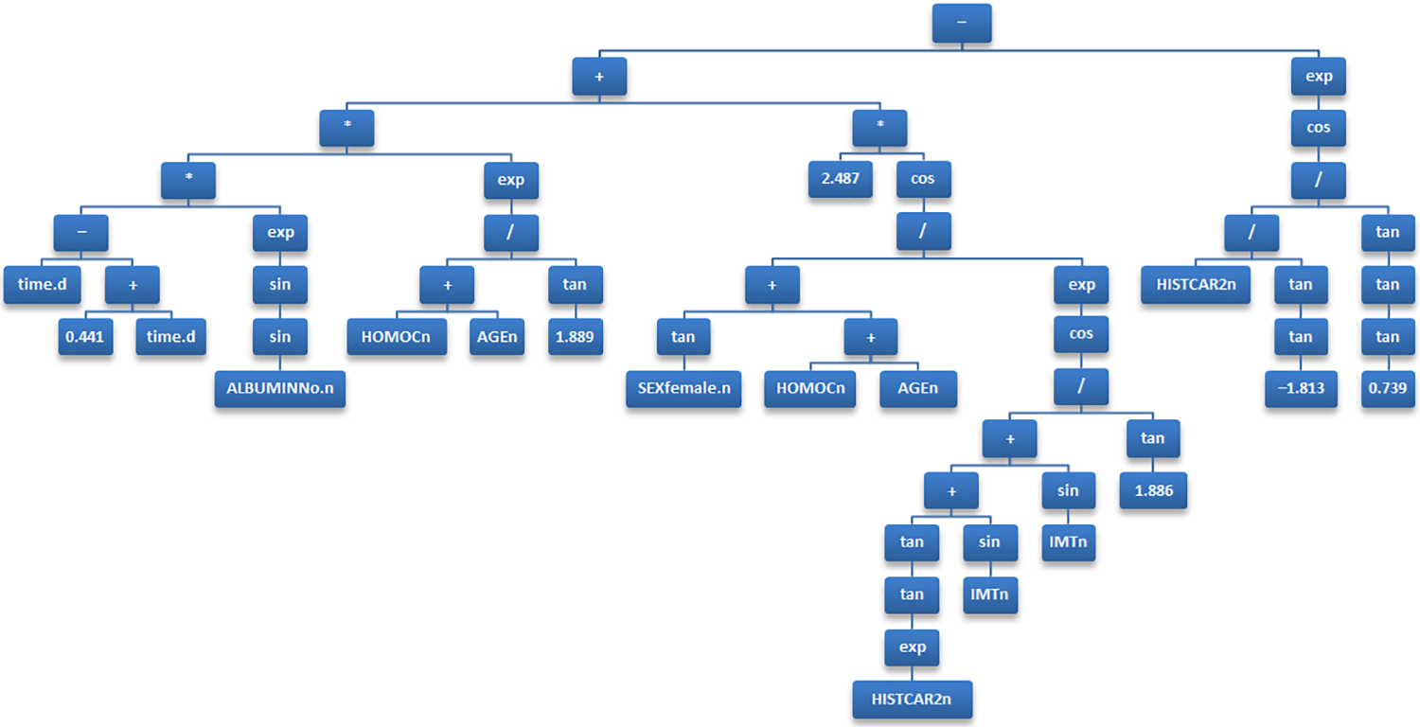
GP Tree
以下是最终生成的树形图
Notes:
The European Union (EU), headquartered in Brussel, Belgium, is a European Community with six founding members, namely Germany, France, Italy, the Netherlands, Belgium and Luxembourg. The Alliance now has 28 Member States and 24 official languages. In December 1991, the Maastricht Summit of the European Community adopted the Treaty of the European Union, commonly known as the Maastricht Treaty. On November 1, 1993, the Treaty of Maastricht came into force and the European Union was formally born. In 2012, the European Union won the Nobel Peace Prize.

